Slide 1
Analysis of laser and Circuit Cam parameters for making cuts in 4mil stainless steel shims.
Conclusions:
Best recipe parameters for 4mil, 304 stainless cuts:
Frequency = 100 kHz
Power = 950W
Mark speed = 250 mm/s
Repetitions = 20
Best recipe success criteria:
Sample cuts out with minimal bending required.
Minimized damage/burning around cut.
Minimal kerf.
For closed loop objects (astm dogbones, single geometric objects such as squares or circles) use “Modify->Convert to closed outline path”. For complicated objects that cannot be converted to closed paths in Circuit Cam, use “Modify-> Convert to one flash”.
If mark speed is too high relative to frequency, the individual laser pulses can be observed in the cut.
R. Greb, ATAMI, Oregon State University, June-19-2019

Slide 2
Top down images of cuts that produced samples that popped out of the shim.
4 is shown after the center fell out so, it’s inner edge is not the same as the others.
1
2
3
4

Slide 3
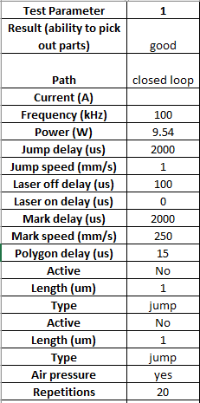
Single line (no repeats)
Frequency/powered varied as shown
4
5
8
1

Slide 4
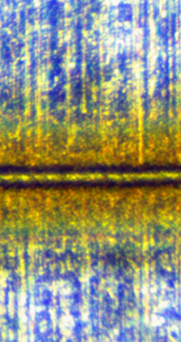
8
5
4
Close up of the same 3 cuts as the previous slides.

Slide 5
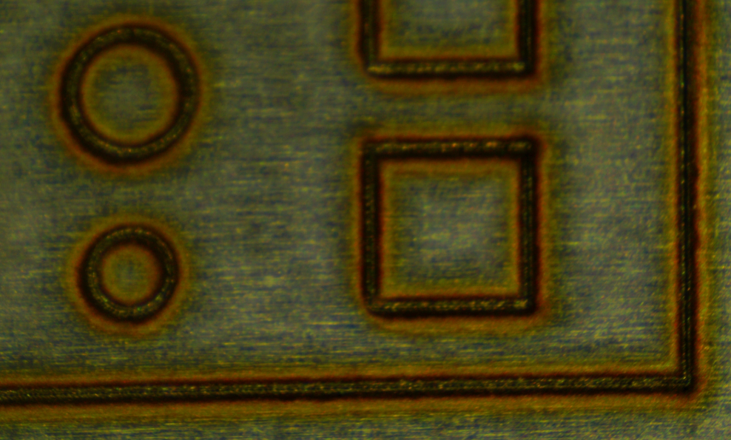
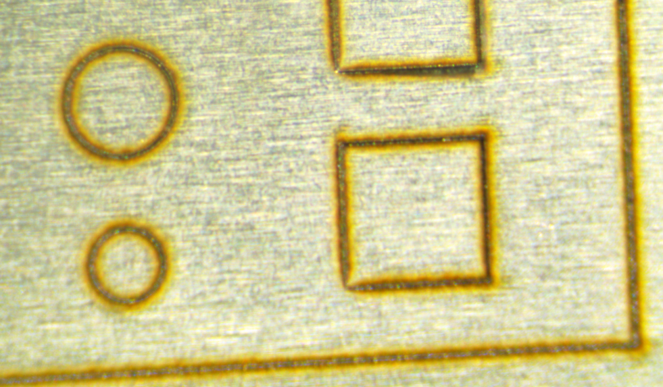
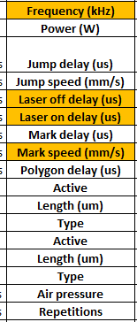
Top down images of the cuts from a test structure.

Slide 6
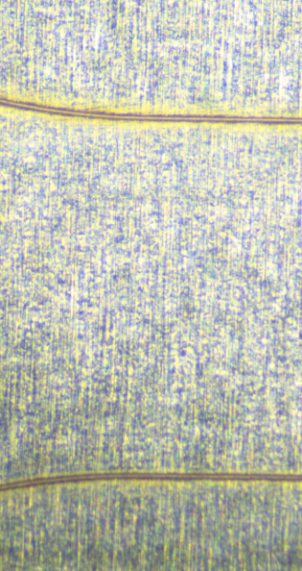
CircuitCAM 6.2:
A - “Modify->Convert to closed outline path”
B - “Modify-> Convert to one flash”
These are single path cuts with the two file conversion methods.
You can see that the closed outline path has a more complete cut line.
A
B

Slide 7
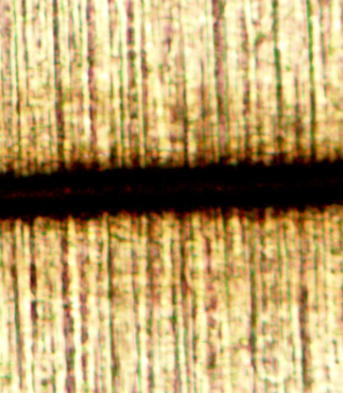
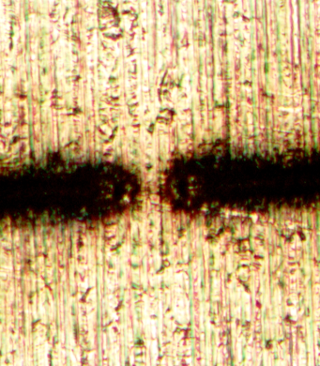
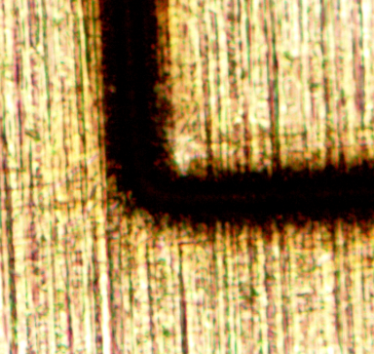
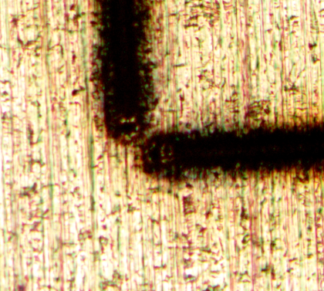
A
B
Close ups of same cuts from previous slides.

Slide 8
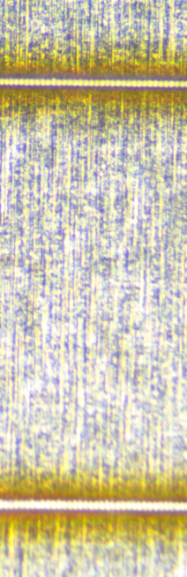
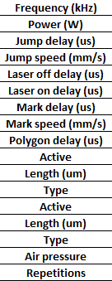
This shows the effect of a very high mark speed relative to the same laser frequency:

Slide 9
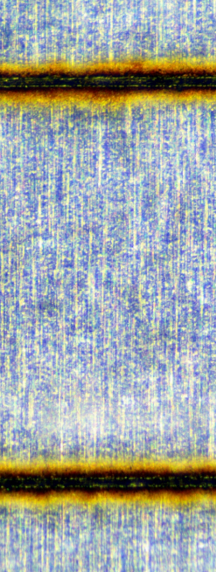
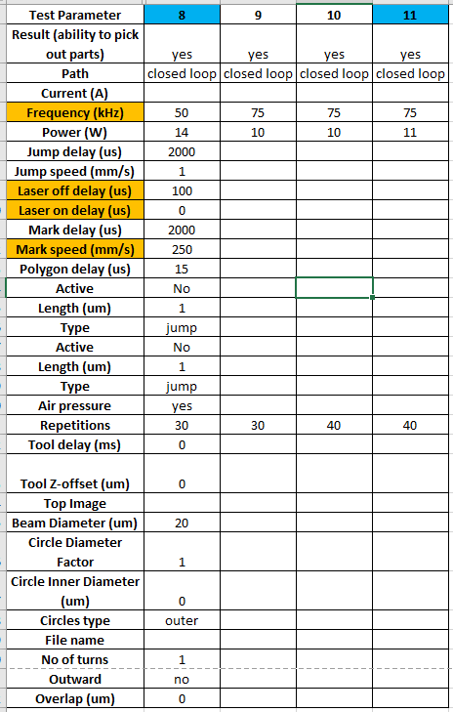
8mil shim cuts:
8
9
10
11

